Slide 1
Unit 12 Capacitors
Part A: Structure and
Types of Capacitors

Slide 2
What will you learn?
The basic structure and characteristics of a capacitor.
Types of capacitors.

Slide 3
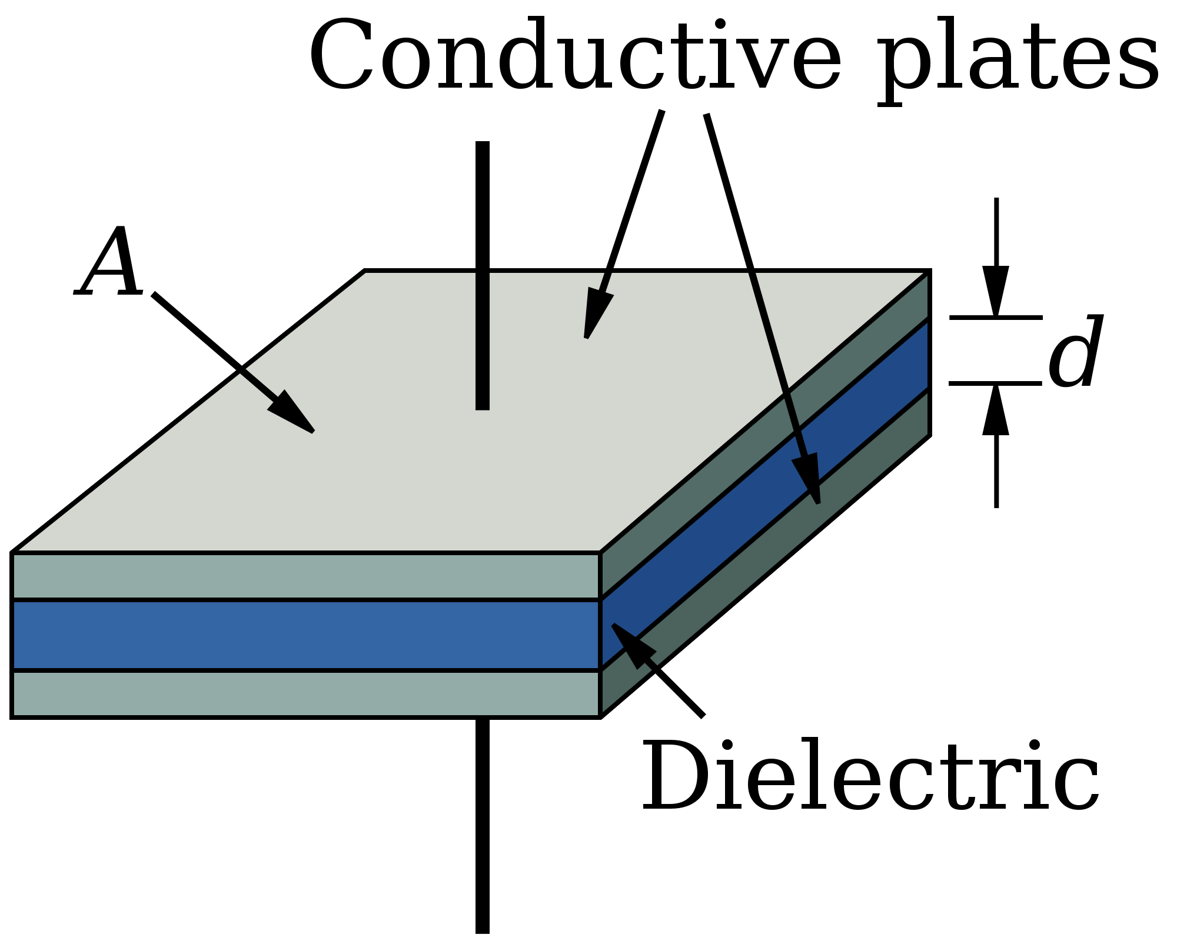
Function & Structure of Capacitor
Has the ability to store electrical energy.
Basic Construction: Consists of 2 parallel conductive plates separated by an insulating material called dielectric.
Connecting
lead
Symbol

Slide 4
Capacitance
The higher the charge Q stored, the higher the voltage V across the plates of a capacitor.
The larger the capacitance, the higher the charge storing ability.
Unit of capacitance is farad (F).
A 1 F capacitor exhibits 1 V across its plates when 1 C of charge is being stored.
Q = C V
Q = Charge stored
C = Capacitance
V = Voltage across capacitor

Slide 5

Physical Characteristics of a Capacitor
Amount of Capacitance is related to how the capacitor is constructed.
It is directly proportional to plate area.
$$C∝A$$
A
A
Full plate area:
More capacitance
Reduced plate area:
Less capacitance

Slide 6
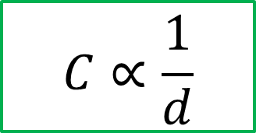
Physical Characteristics of a Capacitor
Capacitance is also inversely proportional to distance between plates.
$$C∝\frac{1}{d}$$
d
d
Smaller distance, higher capacitance
Larger distance, lower capacitance

Slide 7

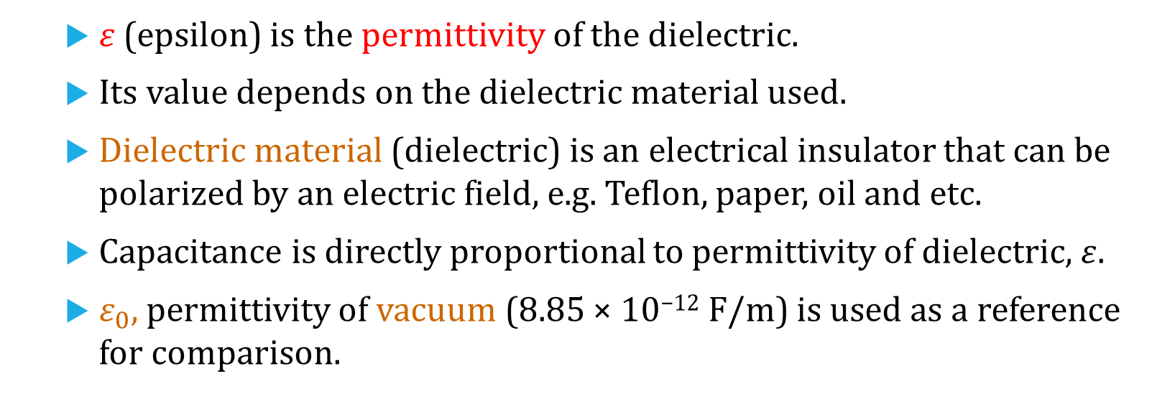
Physical Characteristics of a Capacitor
Capacitance is also affected by the type of dielectric used.
$$C∝ε$$
𝜀 (epsilon) is the permittivity of the dielectric.
Its value depends on the dielectric material used.
Dielectric material (dielectric) is an electrical insulator that can be polarized by an electric field, e.g. Teflon, paper, oil and etc.
Capacitance is directly proportional to permittivity of dielectric, $ε$.
$ε_{0}$, permittivity of vacuum (8.85 × 10⁻¹² F/m) is used as a reference for comparison.
epsilon nought

Slide 8
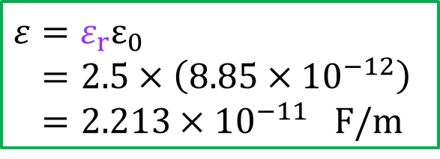
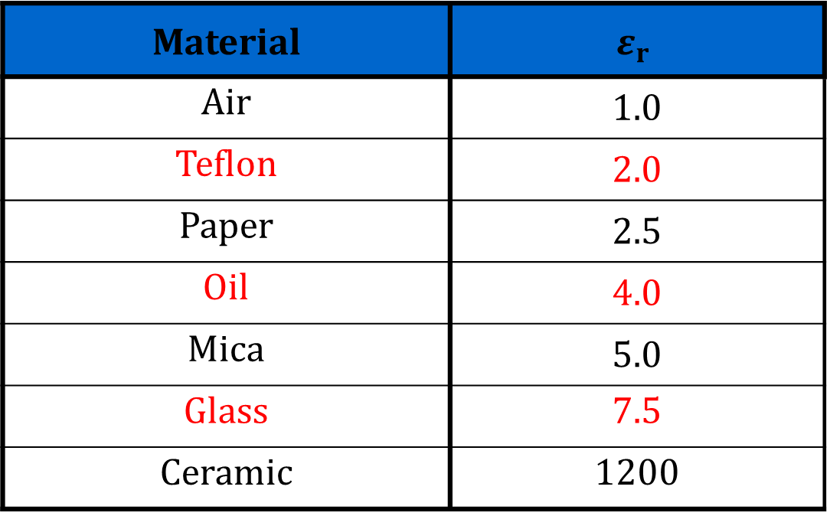

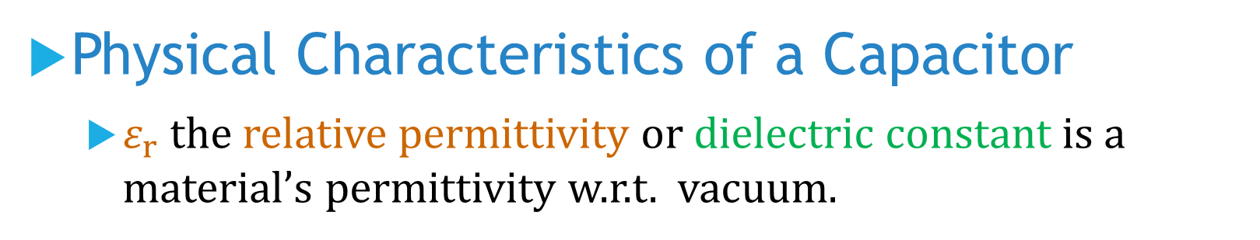
Physical Characteristics of a Capacitor
$ε_{r}$ the relative permittivity or dielectric constant is a material’s permittivity w.r.t. vacuum.
$$ε_{r}=\frac{ε}{ε_{0}}$$
Material | $$ε_{r}$$
Air | 1.0
Teflon | 2.0
Paper | 2.5
Oil | 4.0
Mica | 5.0
Glass | 7.5
Ceramic | 1200
$${ε=ε}_{r}ε_{0}$$
$$=2.5×\left(8.85×{10}^{−12}\right)$$
$$=2.213×{10}^{−11} F/m$$

Slide 9
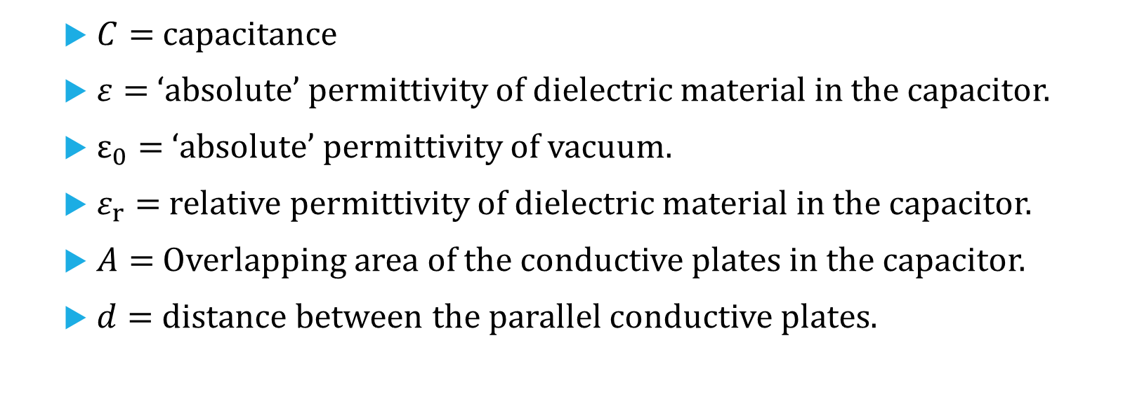




Formula for Capacitance
$$C∝A$$
$$C∝\frac{1}{d}$$
$$C=ε\frac{A}{d}=ε_{r}ε_{0}\frac{A}{d}$$
$$C∝ε$$
$C=$capacitance
$ε=$ ‘absolute’ permittivity of dielectric material in the capacitor.
$ε_{0}=$ ‘absolute’ permittivity of vacuum.
$ε_{r}=$ relative permittivity of dielectric material in the capacitor.
$A=$ Overlapping area of the conductive plates in the capacitor.
$d=$ distance between the parallel conductive plates.

Slide 10
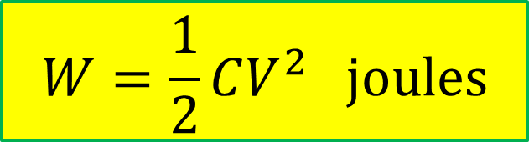
How a Capacitor Stores Energy
Energy stored in the form of an Electric Field established by opposite charges on both plates.
Electric field: lines of force between positive and negative charges pass through the dielectric material.
Energy stored in capacitor.
Lines of electric force
Plate A
Plate B
R
$$W=\frac{1}{2}CV^{2} joules$$
+
−
Battery
V_{S}

Slide 11
Issues of Real Capacitors
Voltage Rating
Real capacitors can breakdown and start conducting if voltage applied to it is too high.
Capacitor’s Voltage Rating - Maximum dc voltage that can be applied to it.
Also called breakdown voltage or working voltage.
Dielectric Strength
Dielectric strength of a dielectric determines breakdown voltage of a capacitor.

Slide 12
Issues of Real Capacitors
Leakage
Dielectric is not perfect electric insulator.
A very small amount of current is conducted between the 2 plates.
As a result, any charge stored by a capacitor will eventually leak off.

Slide 13
Types of Capacitors
Capacitors are classified according to
the type of dielectric materials used,
whether they are polarized or non-polarized, and
whether the capacitance is fixed or variable.
Common types of dielectric materials are
mica,
ceramic,
plastic-film, and
electrolytic (aluminium oxide and tantalum oxide).

Slide 14
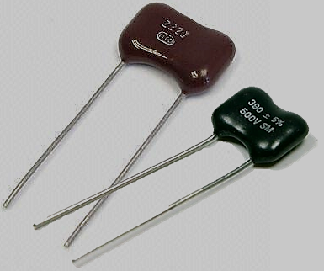
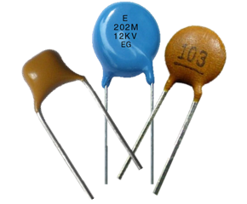

Fixed Capacitors : Non-Polarized
Mica Capacitors
Typical capacitance:
a few pF to a few nF
Voltage ratings:
100 V to 2500 V
Ceramic Capacitors
Typical capacitance:
1 nF to 1 μF
Voltage ratings:
up to 6 kV

Slide 15
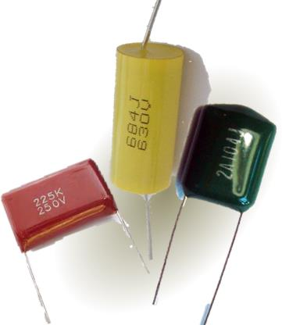

Plastic-film Capacitors
Include polycarbonate, propylene, parylene, polyester, polystyrene and mylar.
Typical capacitance: 1 nF to 30 μF
Polycarbonate Capacitors
Film Capacitors

Slide 16
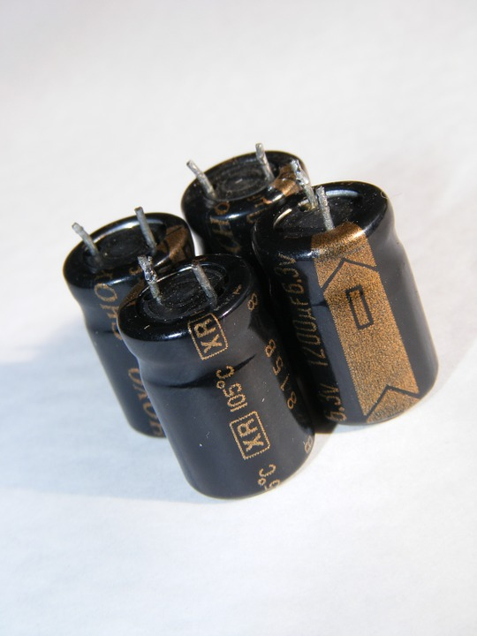
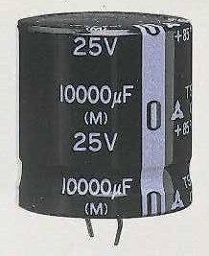
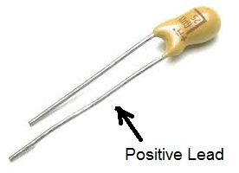
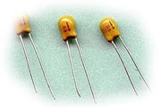
Electrolytic Capacitors :
Polarized
Tantalum
Capacitors

Slide 17


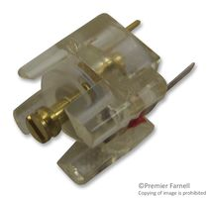

Variable Capacitors
Used when capacitance value needs to be adjustable either manually or automatically.
E.g. radio or TV tuners.
Usually ceramic or mica.
Capacitance is changed by adjusting plate overlap area.
→ See illustration
Symbol of variable capacitor

Slide 18
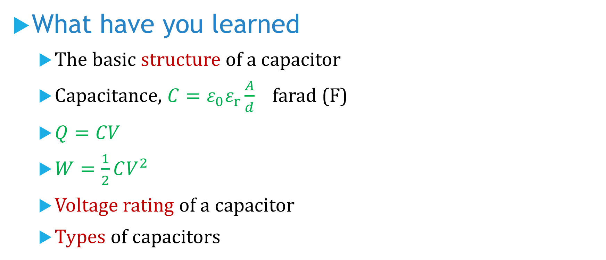
What have you learned
The basic structure of a capacitor
Capacitance, $C=ε_{0}ε_{r}\frac{A}{d}$ farad (F)
$Q=CV$
$W=\frac{1}{2}CV^{2}$
Voltage rating of a capacitor
Types of capacitors

Slide 19
Coming Up Next
Charging and Discharging Processes of Capacitors

